Slide 1
ASSET

Slide 2
What is ASSET?
-ASSET Stands for Assessment of Scholastic Skills through Educational Testing.
-ASSET is a skill-based test that measures student’s conceptual understanding and benchmarks the school’s performance at international, national & regional levels with actionable insights through easy-to-understand reports.

Slide 3
GRADES & SUBJECTS
3 to 10 – English, Math & Science 6 to 10 – Social Studies 5 to 8 – Hindi

Slide 4
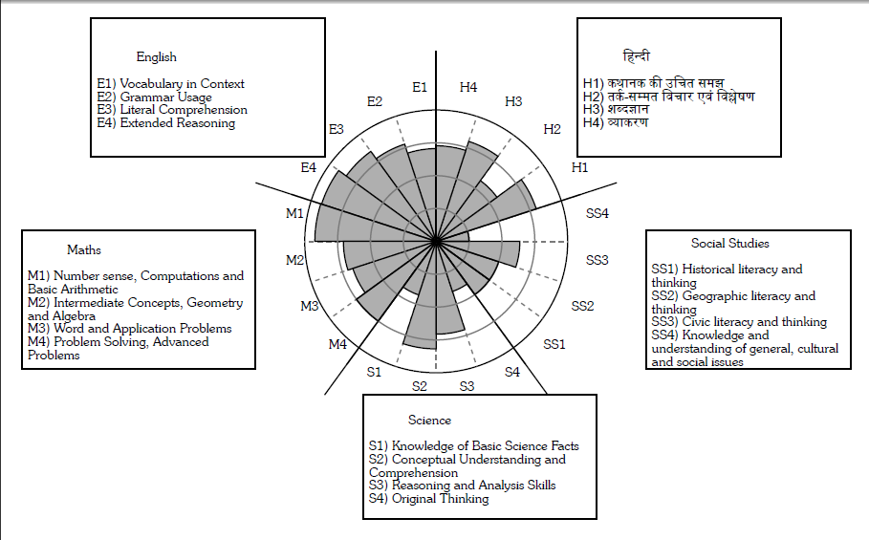
SKILLS

Slide 5
Where do I get the
questions from?
AQAD (ASSET QUESTION-A-DAY) is a set of thought provoking questions picked from the ASSET database to test students' understanding of concepts and is made available daily through this website.
https://www.aqad.in/

Slide 6
AQAD is available for classes 3 to 9 for the following subjects- For Class 3 to 9: English, Math & Science. For Class 5 to 8: Hindi
For Class 6 to 8: SST

Slide 7
Sequence in which the questions are published in AQAD:
Day | Mon | Tue | Wed | Thu | Fri | Sat
Subject | English | Math | Science | Math | Science | SST

Slide 8
Portion for asset?
- There is no particular portion given for Asset.
It contains 1 level low concepts.
It contains essential concepts.
It is curriculum aligned.

Slide 9




What we need to focus on?
FACTS
Which of the following has air in it?
a. b.
c. d.

Slide 10
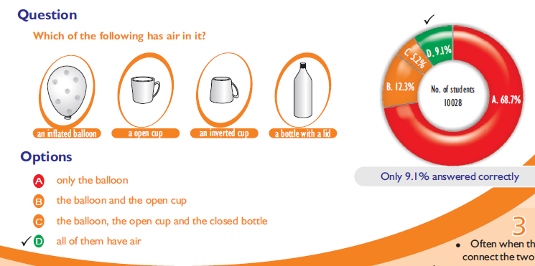

Slide 11
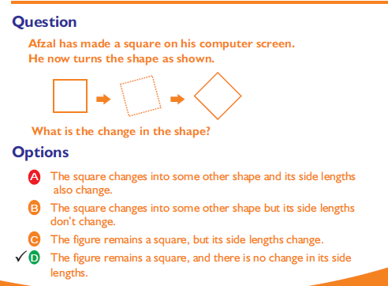

Slide 12

What we need to focus on?
1. MISCONCEPTIONS

Slide 13
How?
Giving more and different examples.
focus on the FACTS.
3. by asking questions such as “How did you come up with that answer?” and “Why do you think it's correct?”

Slide 14
THANK YOU

